Slide 1
CONNECT ME
Your neighborhood app
PRESENTED BY :
Najma manaf
Jesna
Rihana
Liyana

Slide 2
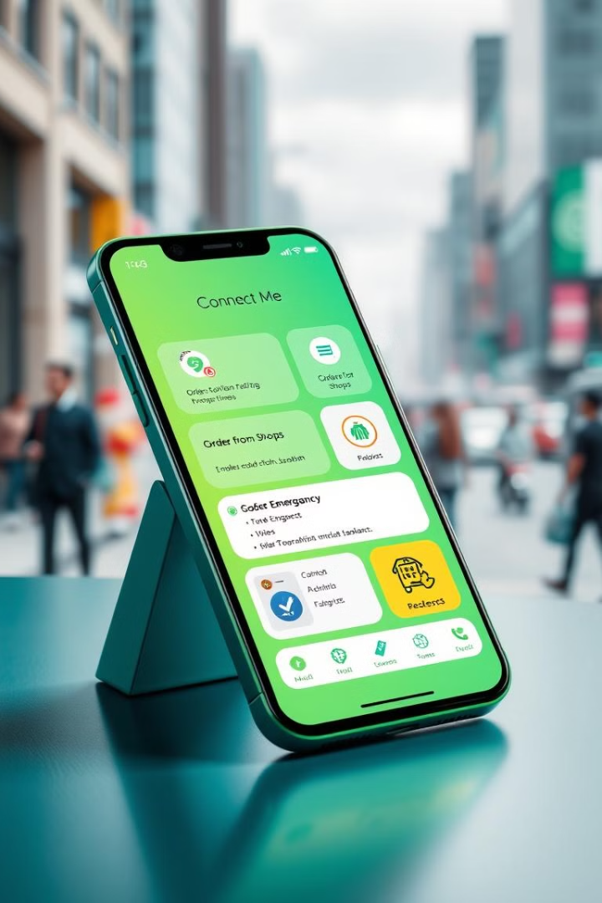
Connect Me
introduction
Connect Me is an innovative Android application designed to simplify the process of accessing essential services and products in your area. This user-centric platform brings together a multitude of functionalities, enabling users to effortlessly discover nearby workers, book services, order from local shops, avail pharmacy services, and even request emergency assistance.
LL

Slide 3
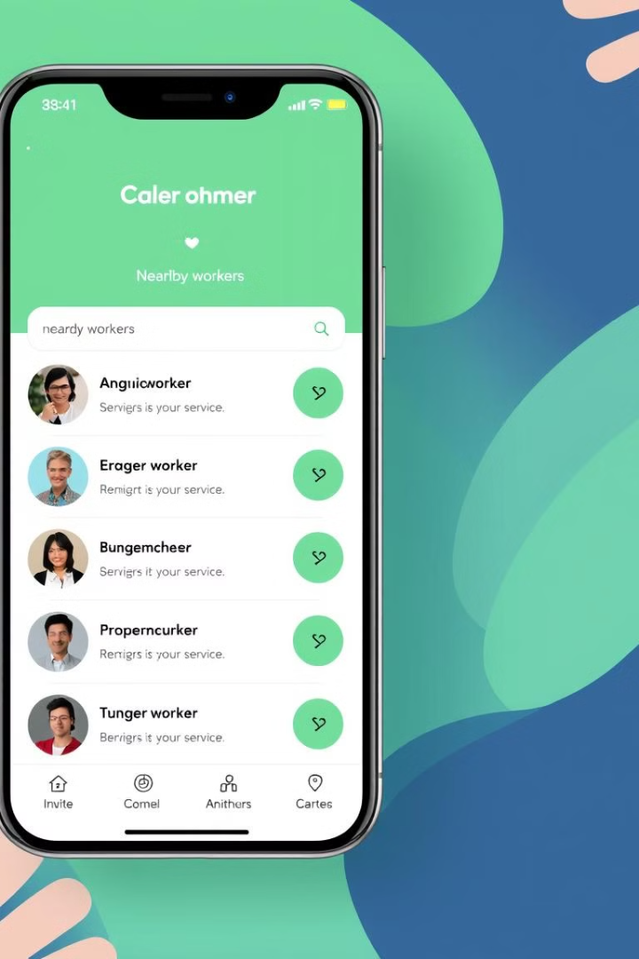
Seamless Service Booking
1
Browse Workers
Users can easily browse through a comprehensive list of service providers available nearby. These workers showcase their expertise and services, making it simple for users to find the right professional for their specific requirements.
2
Book Appointment
Booking an appointment is a breeze, with a streamlined process that guarantees convenience and efficiency. Users can select their desired service, choose a convenient time slot, and confirm their booking with just a few taps.
3
Confirmation & Communication
Upon receiving a service request, workers can promptly review and respond to it, either confirming or rejecting the booking based on their availability and schedule. This interactive feature ensures smooth communication between users and workers, facilitating successful service engagements.

Slide 4
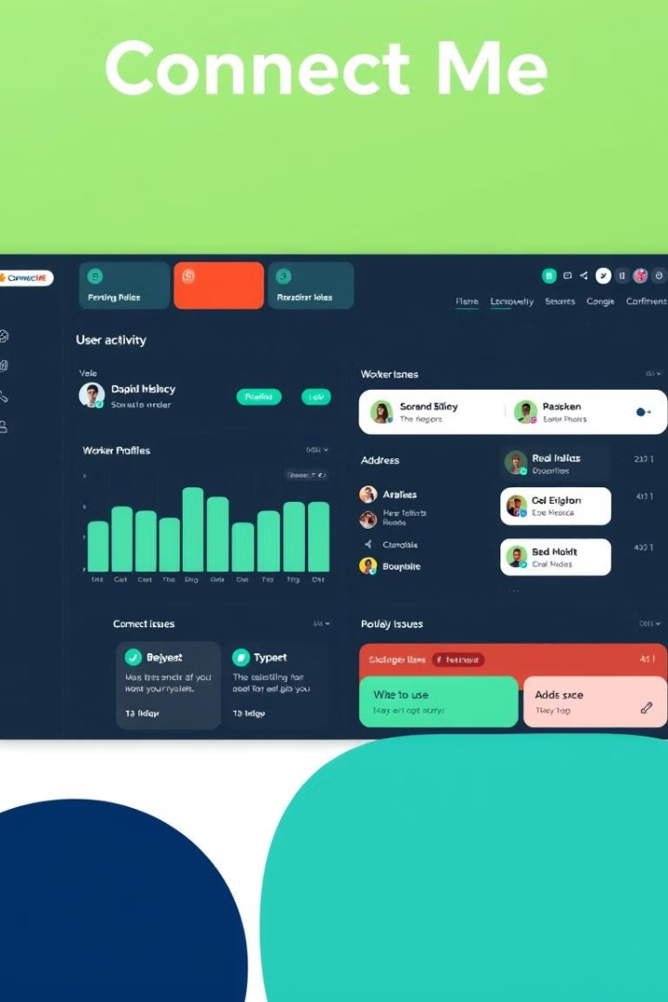
Efficient Administration
User Activity Monitoring
Admins are equipped with powerful management tools, allowing them to monitor user activity, ensuring a safe and reliable environment for all users.
Worker Profile Management
Admins can manage worker profiles, including approving new workers, reviewing their services, and addressing any issues or complaints.
Dispute Resolution
The app's efficient administrative system oversees the entire platform, ensuring its seamless operation. Admins can address any issues or disputes that may arise, ensuring a safe and reliable environment for all users.

Slide 5
Local Shop Integration
Shop Management
User Shopping Experience
Delivery Service
Shops can effortlessly manage their products and stock through a dedicated portal. They can add new products, update inventory, and track sales, all within the app.
The app offers a swift and reliable delivery service, ensuring customers receive their orders right at their doorstep. Users can track their orders in real-time and receive notifications about delivery status.
Users can explore nearby shops, browse their offerings, and conveniently place orders for desired items. The app provides a user-friendly interface for searching products, adding them to a cart, and completing the checkout process.

Slide 6
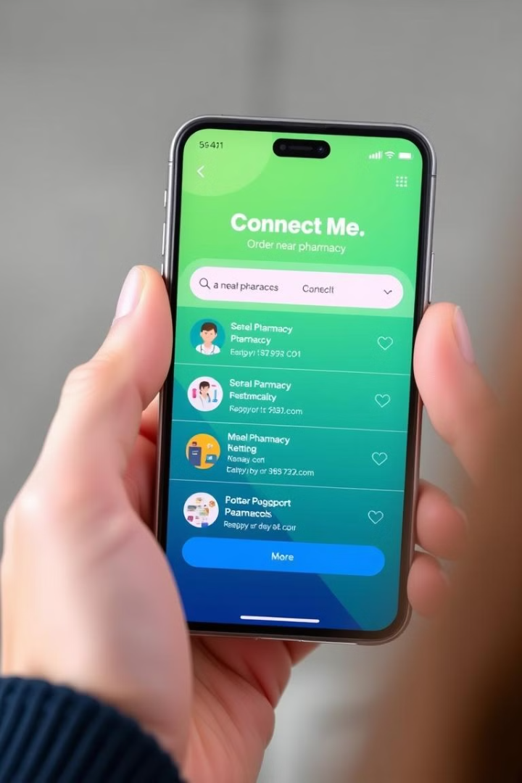
Pharmacy Services
To address essential healthcare needs, Connect Me also features a pharmacy service. Users can conveniently order medicines through the app, streamlining the process of accessing vital healthcare products. The app ensures secure and reliable access to medications, providing users with a convenient and efficient solution for their healthcare needs.

Slide 7
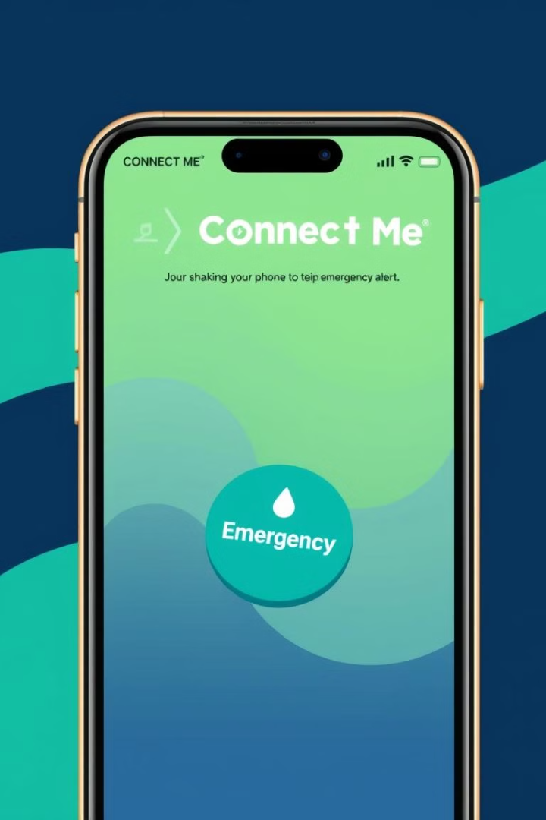



Emergency Assistance
Emergency Request
When users find themselves in urgent situations, they can initiate an emergency request by either shaking their phone or using the volume buttons.
Alert Notifications
Nearby users will receive alerts about the emergency, facilitating prompt assistance and support. The app utilizes location data to identify nearby users who can provide help.
Community Support
The emergency feature fosters a sense of community by connecting users in need with those who can provide assistance. This feature empowers users to help each other in critical situations.

Slide 8
1
Admin
The admin module manages the entire platform, including approving new shops and workers, monitoring user activity, and resolving disputes.
2
Shops
Module Descriptions
The shop module allows local businesses to manage their products, stock, orders, and customer interactions.
3
Workers
The worker module enables service providers to manage their profiles, services, bookings, and customer reviews.
4
Users
The user module provides a platform for individuals to access services, order products, and request emergency assistance.

Slide 9
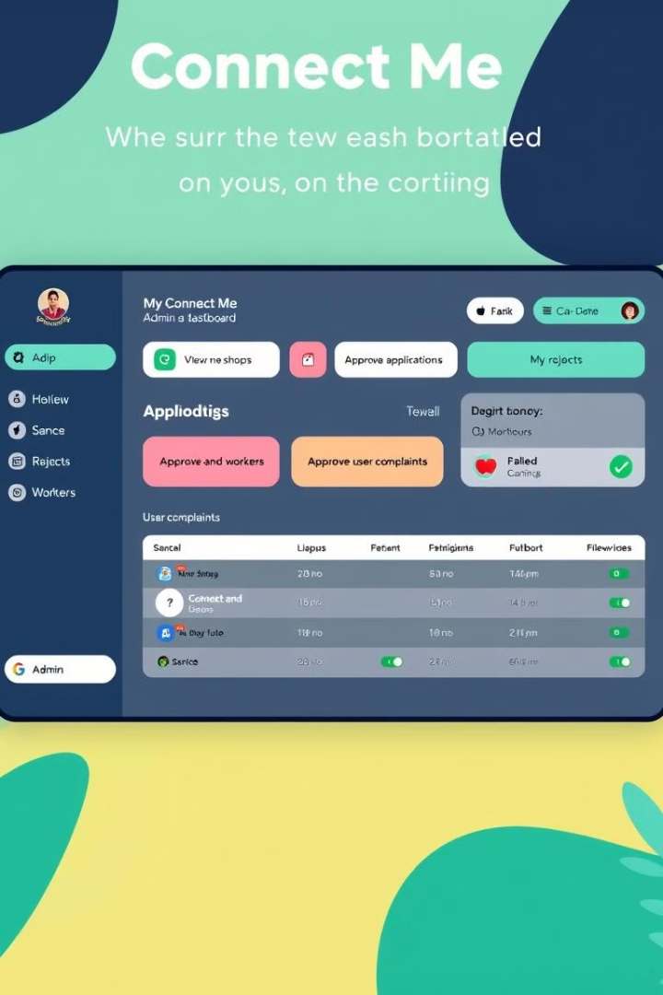
Connect me
Admin Functions
Login
View new shops and approve
View approved shops
View rejected shops
View new workers and approve
View approved workers
View rejected workers
View registered users
View complaints and send replies
Change password

Slide 10





Shop Functions
Signup
Login
Product Management
View Orders
Shops can create an account on the platform, providing their details and information.
Shops can access their account and manage their operations.
Shops can track orders placed by users and manage their fulfillment.
Shops can add, edit, and remove products from their inventory.

Slide 11
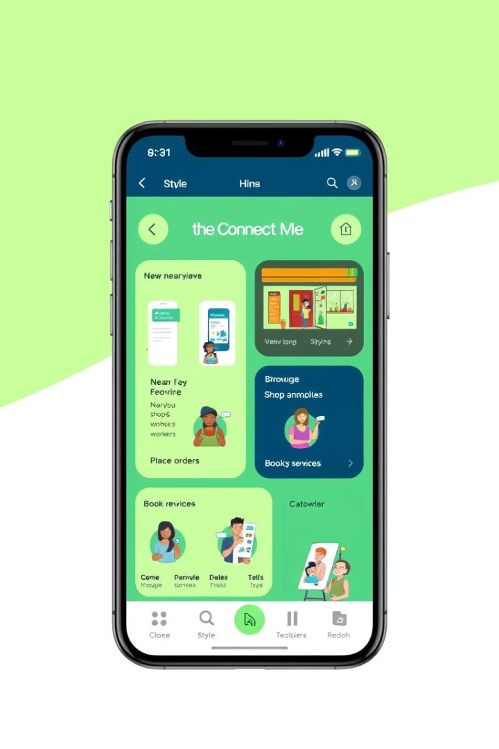
User Functions
1
Search Nearby Shops
Users can easily find local shops based on their location and product categories.
2
Search Nearby Workers
Users can search for service providers based on their expertise, location, and customer reviews.
3
Book Services
Users can book services from verified workers, schedule appointments, and track their bookings.
4
Place Orders
Users can browse products from local shops, add them to their cart, and place orders for delivery.

Slide 12

Worker functions
Account & Services
1
Sign Up & Log In
2
Manage Service
Create an account and access the platform.
Configure your services and set charges.
3
View Profile
4
Change Password
Review and update your personal information.
Request & Communication
6
Feedback & Support
5
View Requests
Access user reviews and feedback.
See new requests from users.
Respond to complaints.
View replies to your complaints.

Slide 13
Database Tables
Table Structure
Table 1: Login
Field Name | Data Type
Login_id | int
Username | varchar
Password | varchar
Usertype | varchar
Table 2: shop
Field Name | Data Type
Shop_id | int
Login_id | int
Shop_name | varchar
Place | varchar
Pin | int
Type | varchar

Slide 14
Table 3: User
Field Name | Data Type
User_id | int
Login_id | int
First_name | varchar
Last_name | varchar
Place | varchar
Phone | int
Table 4: worker
Field Name | Data Type
Worker_id | int
Login_id | int
First_name | varchar
Last_name | varchar
Place | varchar
Work | varchar
Phone | int
There are more tables in this project that are: order_master,order_details,order_payment,product,review_product,review_worker,service,
request,and request_payment.

Slide 15
Tools & Technology
For the “Connect Me” project, the following tools and technologies can be utilized to ensure smooth development, operation, and scalability.
Front-end
Back-end
Data Base
Html
Css
Javascript
Python
Android
Mysql
Software Used
Visyal Studio Code

Slide 16
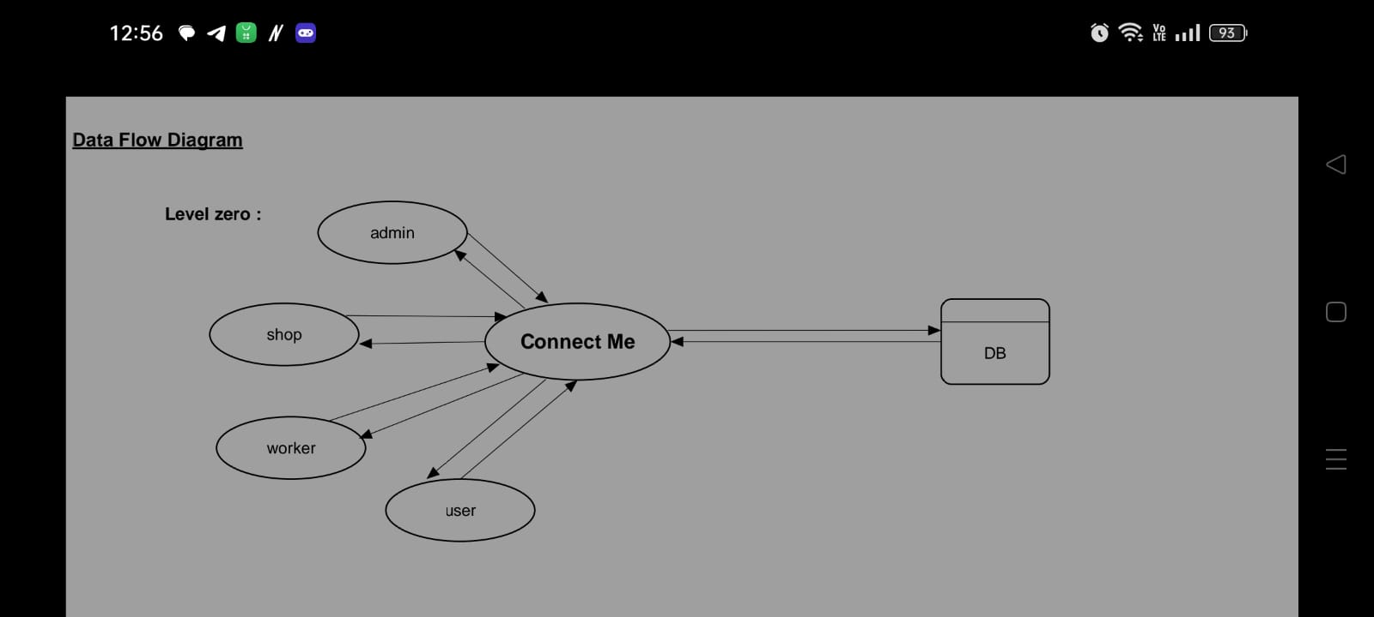
Data Flow Diagram

Slide 17
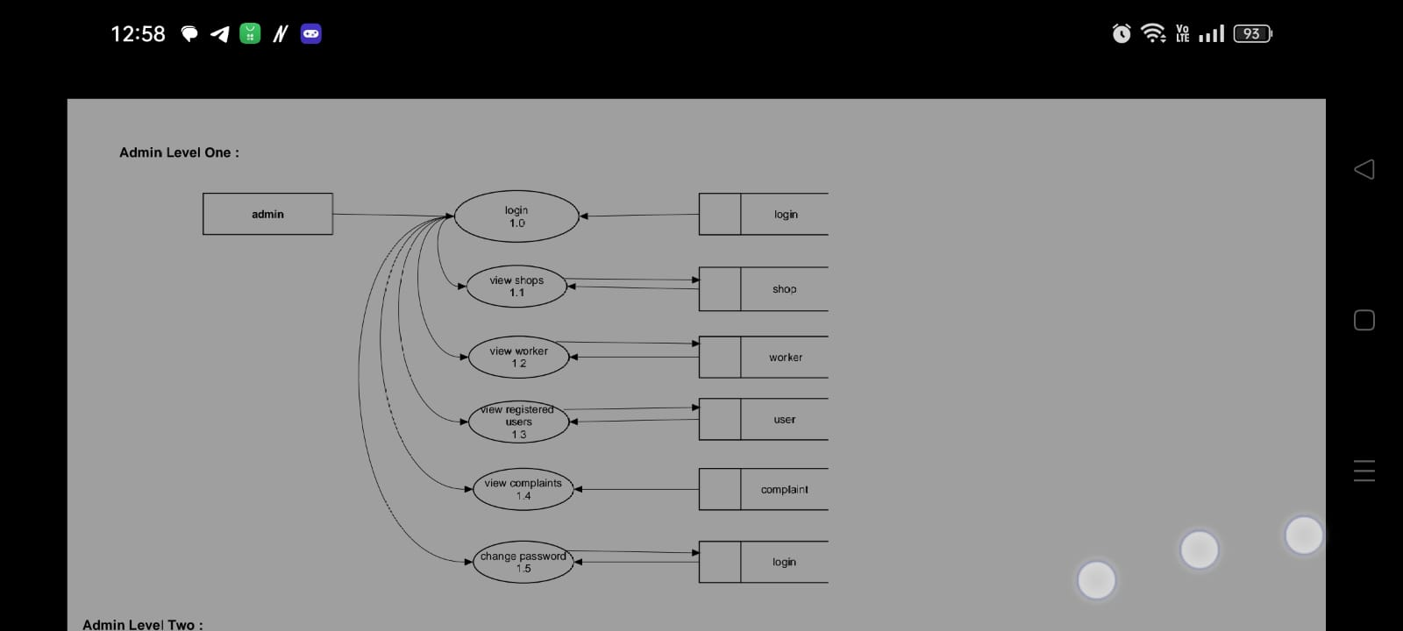

Slide 18
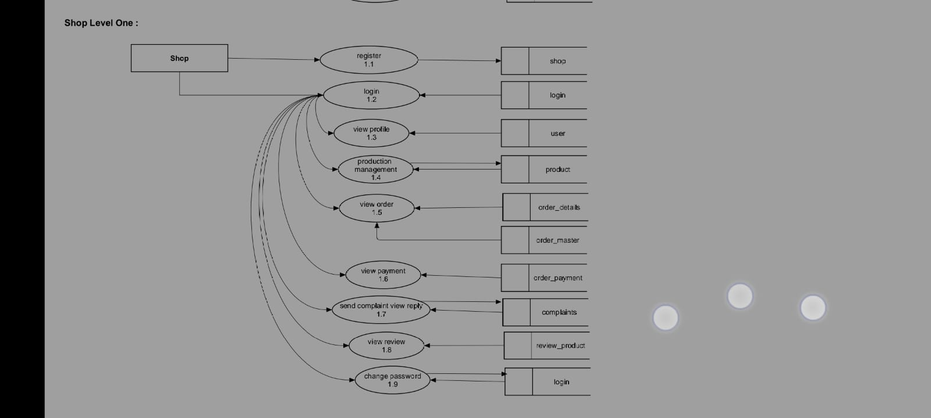

Slide 19
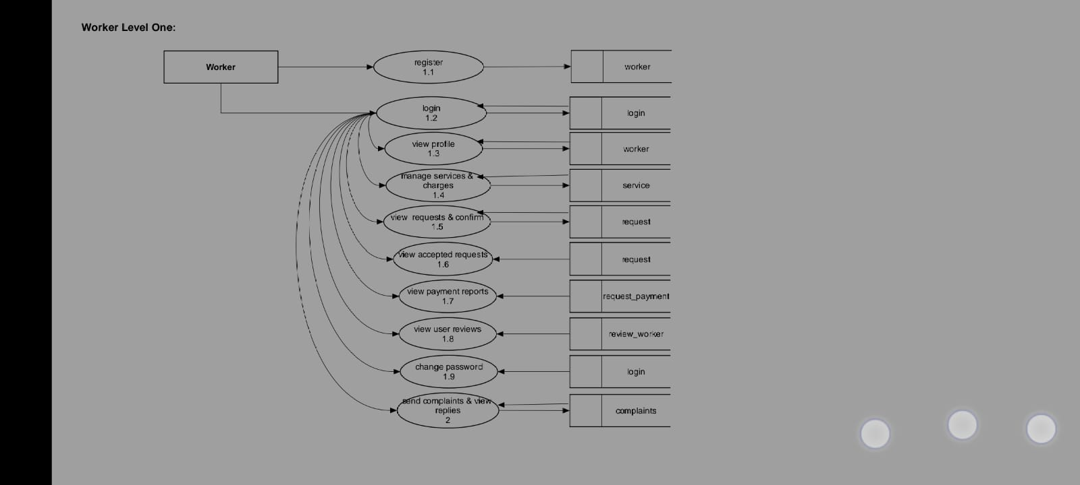

Slide 20
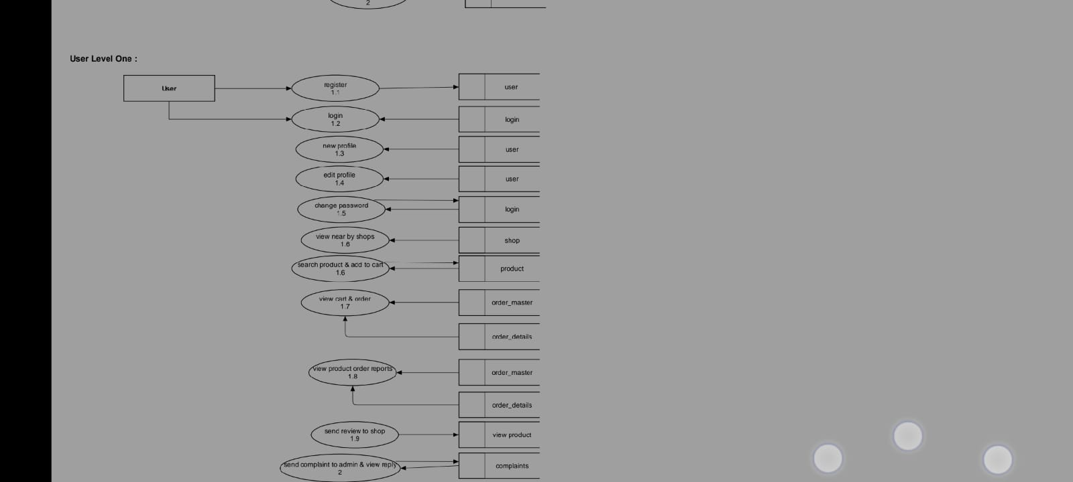

Slide 21
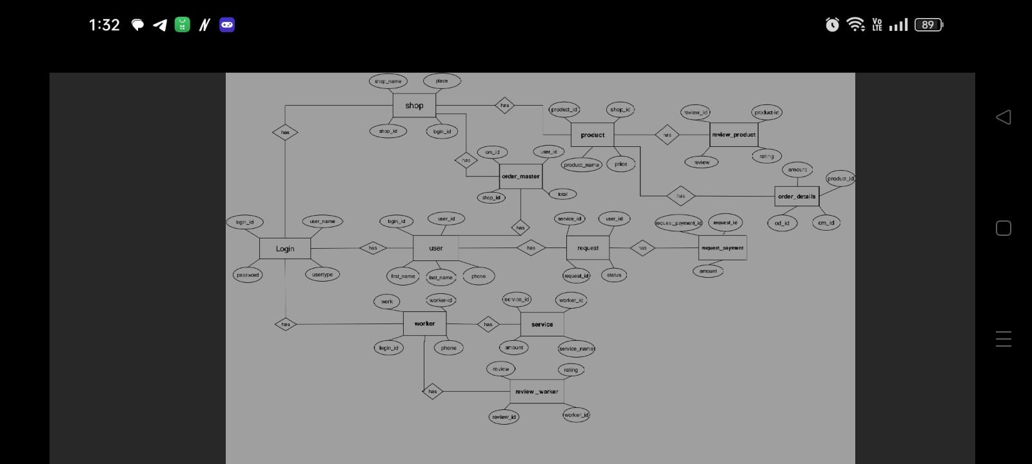
ER Diagram

Slide 22
Conclusion
As we look to the future “Connect Me” revolutionizes the way you access essential services and products, empowering you to live a more connected and convenient life.
Connect Me empowers you to effortlessly navigate you in daily life, all from the palm of your hand.

Slide 23
Future Enhancement
visionary concept
Connect Me offers a unique and comprehensive solution for connecting people to local services and products.
Growing market
The demand for convenient and accessible local services is increasing rapidly
Strong business model
Connect me generates revenue through commission fees on transactions and subscriptions for premium features
Join us
Invest in Connect Me and be a part of the future of the local connectivity

Slide 24
THANK YOU

